Slide 1
Conclusion Report
Smart Flappy Bird
Liqin She Qinglin Zhang
Yinghao Ge Hongming Zhang
TAQ Honors Program
JiLin University, China
4th June, 2018

Slide 2
Conclusion Report
Contents
Introduction
Analysis
Design
Implementation
Testing
Conclusion & Results

Slide 3
Conclusion Report
Introduction
We often heard about AI and machine learning. Now, we learnt C, so maybe we can achieve it. Therefore, we chose Flappy Bird and Q-learning.
Smart Flappy Bird is a video game based on Flappy Bird, a popular game designed by DongNguyen (Vietnam). But our bird can learn by itself to play the game, and scores more than human players. Also, we combined the traditional mode and self-playing mode, so players can have a better experience.

Slide 4
Conclusion Report
Yinghao Ge
Group Division
Liqin She
Hongming Zhang
Learn
Q-learning arithmetic
Qinglin Zhang
A “@” can learn how to fly
Create a simple game
Smart flappy bird
Ordinary Flappy Bird
Finished time
5.31
Learn interface optimization
Finished time
5.15
Finished time
4.20

Slide 5
Conclusion Report
Analysis
Recently, we have heard of too much news and information about AI. We know it can achieve some unbelievable functions. So our project just exerts a simple arithmetic, Q-learning, to show its learning process. To make a contrast with the version which inserted Q-learning arithmetic, we also made an ordinary version. Throughout this, maybe we can feel the power of machine learning.

Slide 6
Conclusion Report
Design
Start
Right ?
Ordinary mode
yes
no
Q-learning mode
End

Slide 7
Conclusion Report
Design
knock on the ceiling or ground?
Yes
bird died and end the game
bird gets a new position
No
in the same line with the first barrier?
No
bird falls towards ground
Yes
Yes
the bird is in the interval?
No
in the same line with the second barrier?
No
bird jumps?
Yes
Yes
No
Yes
the bird is in the interval?
score plus one
barriers move horizontally(from right to left)

Slide 8
Conclusion Report
Design of Q-learning
There is no way to get out of this cycle
Loading the original data
Update arr_R and arr_Q(R and Q)
This will be tested by the bird’s learning process and its total performance.
Judge the bird whether to be alive
Get relative location(S)
Bird decide its action(A) directed by arr_Q and pillars move.
Notes:
Firstly, the bird’s statement is confirmed by the relative location.
Then the bird will do action depending on arr_Q.If the number in arr_Q is zero, the bird will fly randomely.
According the bird’s life statement, arr_R will be updated. arr_Q will be updeta by the central equation.
Equation:arr_Q[x][y][action]=0.4*arr_Q[x][y][action]+0.6*(arr_R[x][y][action]+max);

Slide 9
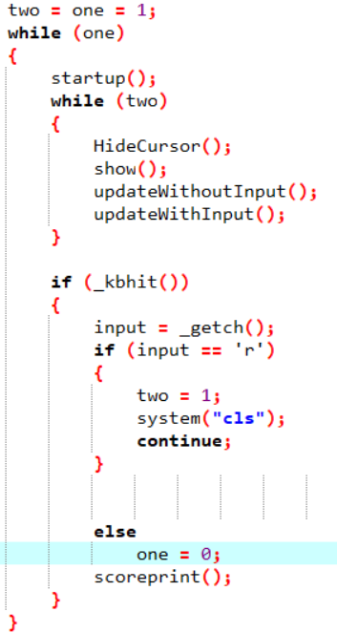
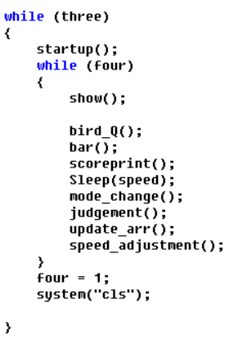
Conclusion Report
Implementation
In order to restart the game without exiting the whole procedure. We inserted a cycle function.
‘one’ means getting into the procedure
‘two’ means getting into the game
start
one
two
exit
restart
In the Q-learning mode, we used ‘three’ and ‘four’ to restart the game automatically.

Slide 10
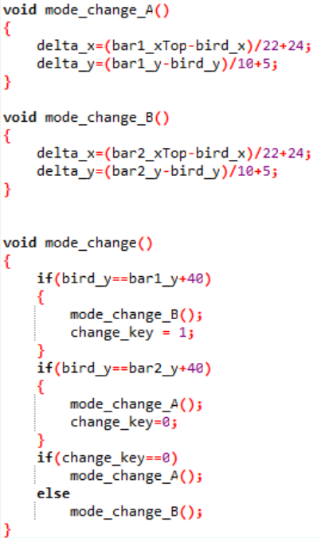
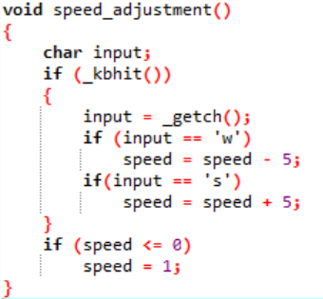
Conclusion Report
Implementation
The difficulties to achieve it are three things:
Changing the relative location. I use mode_change function to transform it.
The other thing is to attempt how can make the bird learn fast and which number can let the bird fly well. I use the speed_adjustment function to adjust the speed the game going and try several number to see the result.

Slide 11
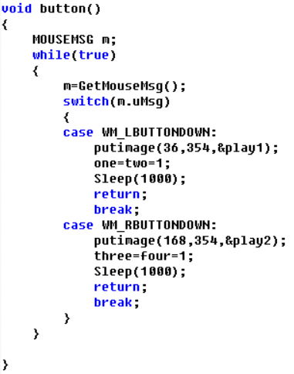
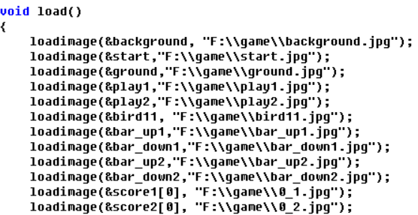
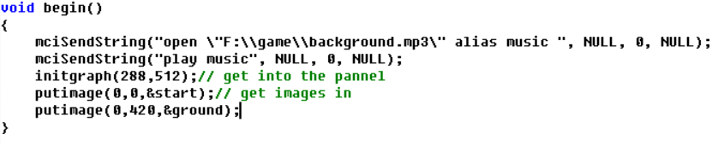
Conclusion Report
Implementation
interfacial design:
Picture loading：I download Easy_X, a plugin to run the functions that load and put pictures.
Picture processing：Most of the picture materials are downloaded from the Internet. Among them, some pictures have margin which can do harm to the result, so I use some orders to get rid of it. Some picture are made by hand.
Others：I learned specific order to load background music, and use the mapping tools in Easy_X to make buttons.

Slide 12
Conclusion Report
Testing
The way to define state and action | The result expected | The real result
S:The state after the action A:1/1000 randomly and arr_Q directs | It can learn well and learn as the simple vision did. | The bird can only learn to fly little and about 20 pillars are its limitation.
S:The state after the action. A:1/1000 randomly, arr_Q directs when there is number not zero. | It can learn better than before and it will faster to pass the first pillar. | It really passed the first pillar faster, but the result still is poor.
S:The wrong state, the delta_x is after action, and delta_y is before action. A:Be the same as the second. | It can learn more than before. | It can’t learn. It will find the way to die. If it find the way to die, it will always do it.
S:The state before the action. A:Be the same as the second. | It can learn better, and just can break the poor record. | It really break it, and learning how to fly in an ideal way. The highest score we haven’t know. But at least, it can pass 10000 pillars.

Slide 13
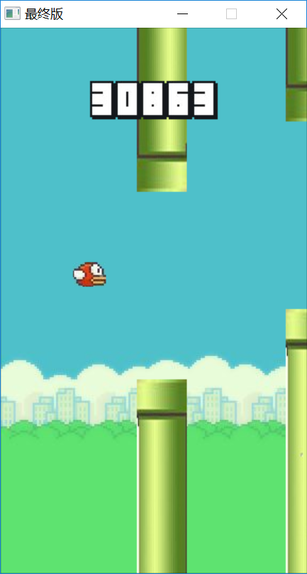
Conclusion Report
Result ＆ Conclusion
Now, we achieved all our imagine.
In the ordinary mode, we can enjoy the classic game.
In the Q-learning mode, the bird can learn how to fly over the barrier very quickly after a period, and easily reach the score of 30,000.

